Slide 1
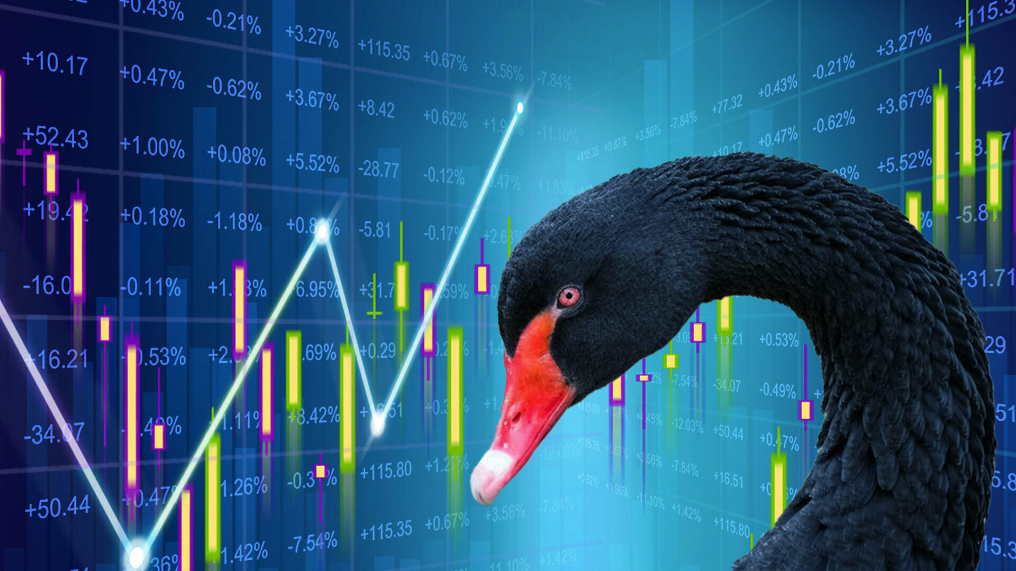

The Black Swan Token
By: Deron Porter, Carl Bent, Chin Hsu, Otha Richardson lll, and Cassandra Toroian

Slide 2
Executive Summary
Aside from the algorithmic trading bots… the fear and greed of investors is what drives the market. Every investor wishes they could predict the market.

Slide 3
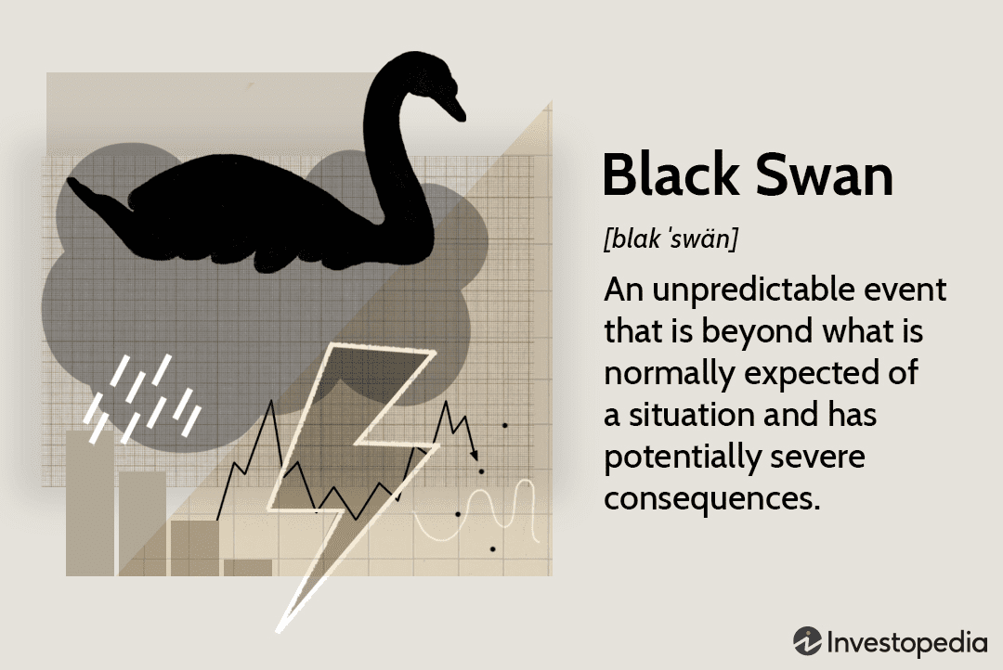
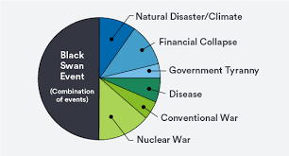
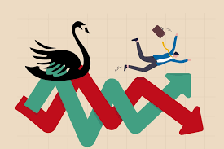

Slide 4
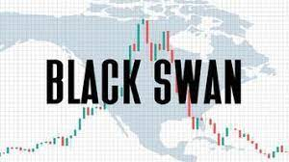
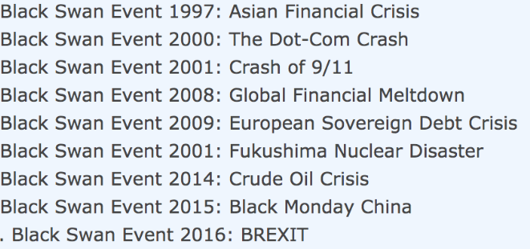
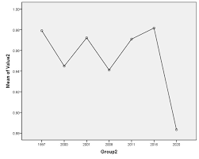
Black Swan Event 2020: COVID-19 Pandemic

Slide 5
Concept
Description
When the market drops during a black swan event, our token will increase in value.
Motivation for development?
People lost a lot of money from the market drop during the pandemic.
There is currently no other option like our token on the market.
Great investment opportunity.
User story
“I am an investor that has PTSD from the 2008 Great Recession and from the market crash in 2020. I am looking for an investment that will keep me from losing money during the next black swan event.”

Slide 6
Data Techniques
Description of data source.
SPDY, DJIT, NASDAQ, FTSE, VIXX, SPX, Treasury Bond, SSE Shanghai SE composite index, Hang Seng
Reasoning for data selection.
All of the ETFs and Indexes represent a certain market or commodity within the whole financial market
Non Bias
Not only taking the U.S. Markets because Black Swan events affect the whole world.
Collection, exploration and cleaning process.
Based off of 10 international ETFs and indexes our tokens worth is determined by the:
Volume
Price Changes
Percent Change

Slide 7
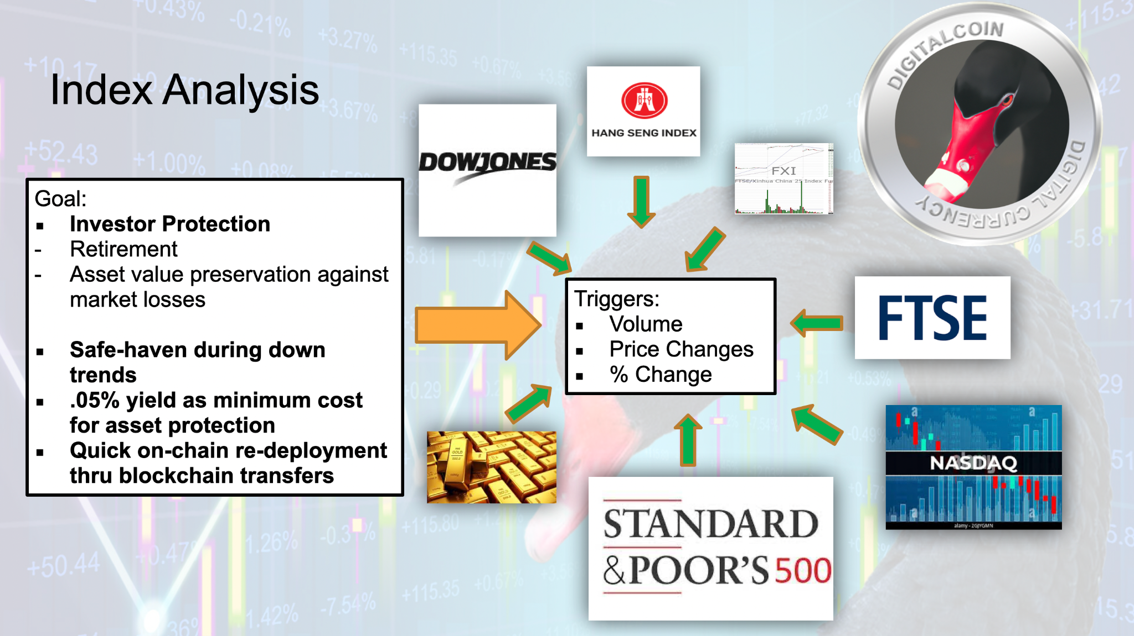

Slide 8
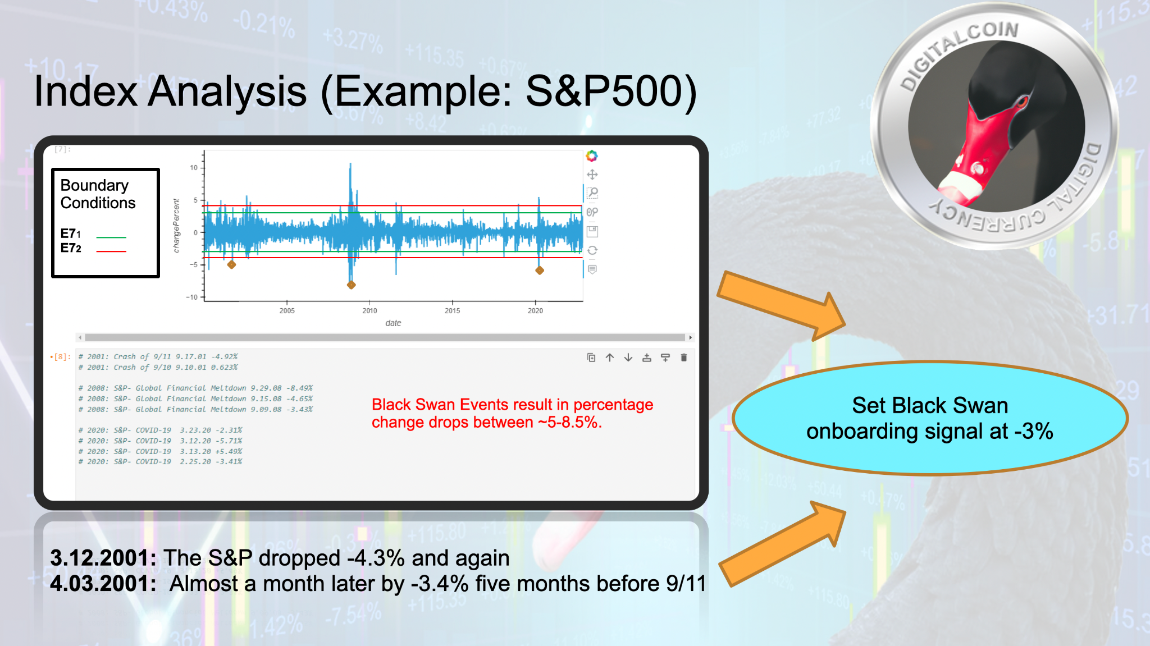

Slide 9
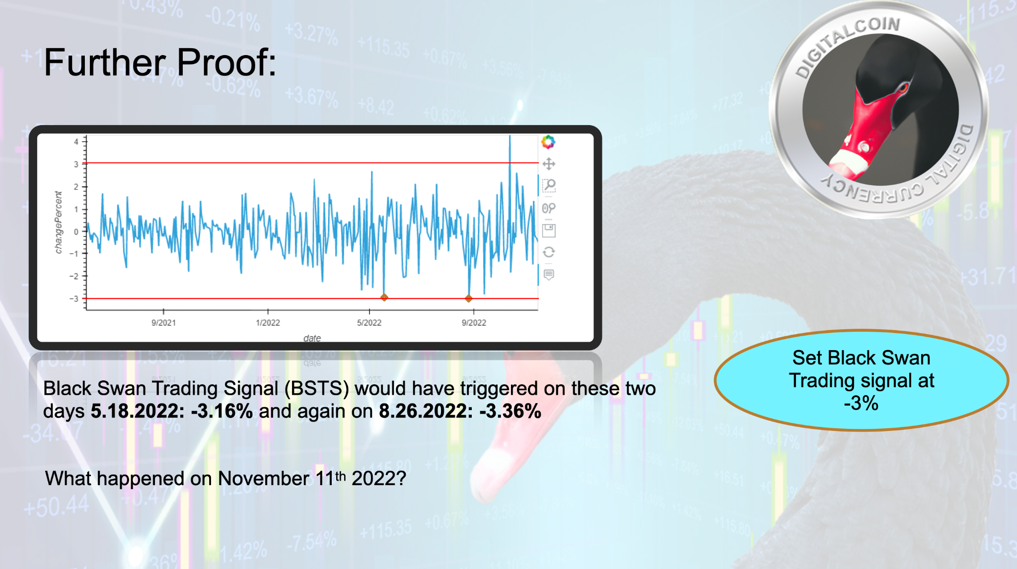

Slide 10
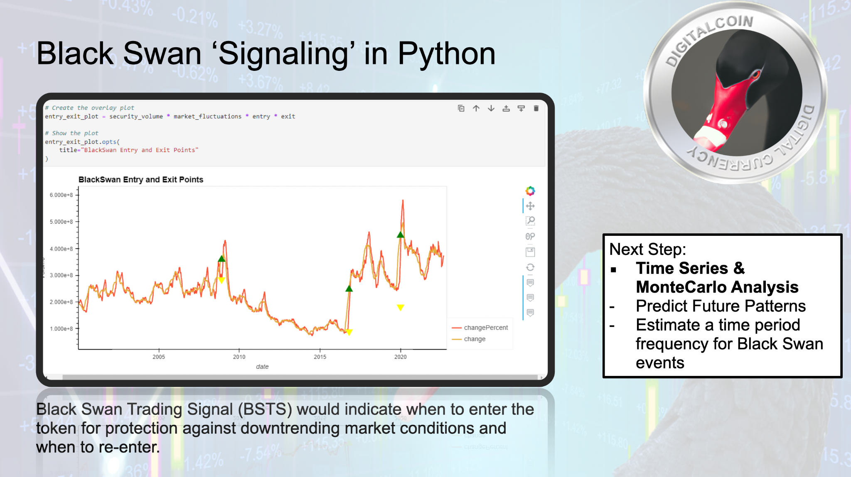

Slide 11
Approach
Technologies used
Languages & Libraries: Solidity (Open Zeppelin and Safemath), Python (Pandas, NumPy)
Platforms: Remix, Jupyter Lab, Visual Studio Code
Amazon Web Services: S3, CloudFront, Route53, EC2, VPC
Breakdown of tasks and roles
Carl- Amazon Web Services (VPC, S3, EC2, and CloudFront) and Powerpoint.
Deron & Chin- Solidity, Web3 and Blockchain.
Otha & Cassandra- Python analysis, APIs, data aggregation and data visualisation.
Challenges
Searching for the right ETFs and indexes to reflect a black swan event.
Working with AWS Route 53 Records
Successes
Configuring a VPC without using the default VPC setting.
Being able to host a streamlit application on AWS

Slide 12

Demo

Slide 13
Next Steps
Additional questions that surfaced.
How do we integrate our project with AWS CloudWatch Alarms?
Why were certain international Stocks were not working with our python API code?
Additional topics to research.
How to market our token to investors and cryptocurrency exchange platforms.
What additional factors contribute to a black swan event?
Plan for future development.
Add a wider range of ETF’s, commodities, and markets.
Bring our token to all major cryptocurrency exchange platforms.
Running time series and monte carlo for future analysis

Slide 14
Our token will prevent you from becoming this…

Slide 15
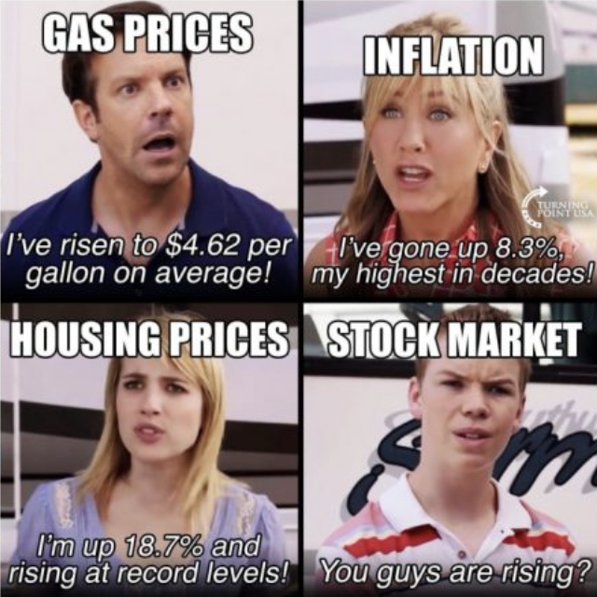
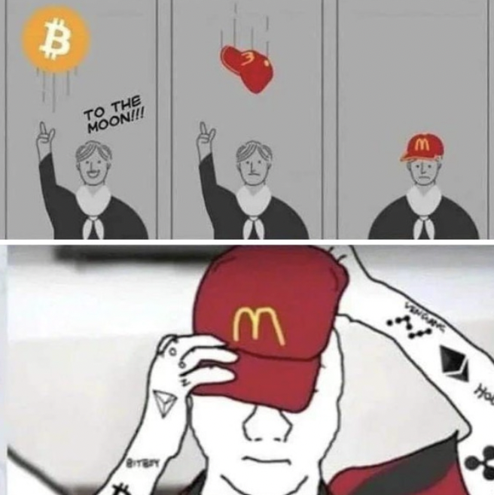
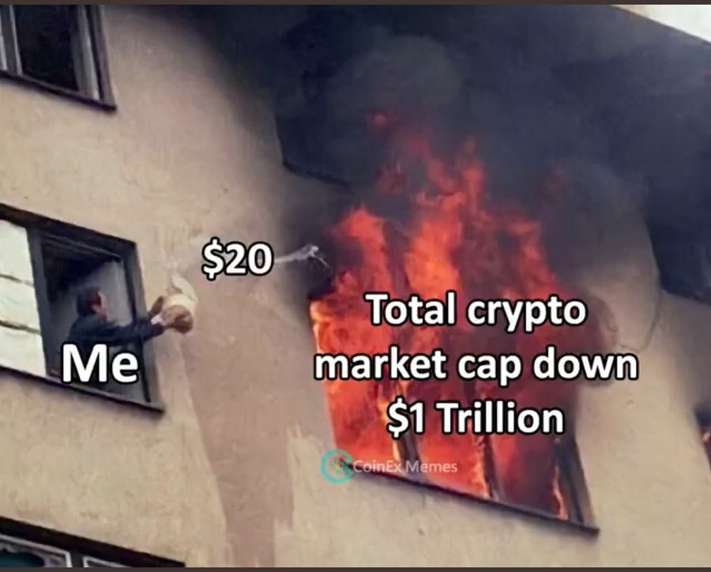

Slide 16
Links
Sources
Deployed application.
GitHub repo.
Our Token
Poll
Investopedia- https://www.investopedia.com/terms/b/blackswan.asp
Corporate Fincance Institute- https://corporatefinanceinstitute.com/resources/economics/black-swan-event/

